Slide 1
CS 129.18
Logistic Regression

Slide 2
Linear Regression
𝐲 = 𝐗𝜷 + ε

Slide 3
A function 𝐲 = x𝜷 + ε
X → data
β → coefficients
ϵ → error in data
y → target

Slide 4
A function 𝐲 = x𝜷 + ε
Notice that the possible values of 𝐲 are from - ∞ to ∞.

Slide 5
T
y₀
y₁
𝐲 =
→
y_{n}
𝐲 is the target variable vector

Slide 6
T
x₀
x₁
x =
→
x_{n}
𝐗 is a vector of features you want to predict with

Slide 7
T
𝜷₀
𝜷₁
𝜷 =
→
𝜷_{n}
𝜷 is the coefficient vector

Slide 8
T
ε₀
ε₁
ε =
→
ε_{n}
ε is the error term or noise vector

Slide 9
Linear regression is basically y = mx +b
Let’s make it more interesting

Slide 10
Multivariate Linear Regression
𝐲 = 𝐗𝜷 + ε

Slide 11
Linear method for modelling the relationship between a dependent or target variable, and one or more or independent variables.

Slide 12
A function 𝐲 = 𝐗𝜷 + ε
X → data
β → coefficients
ϵ → error in data
y → target

Slide 13
T
y₀
y₁
𝐲 =
→
y_{n}
𝐲 is the target variable vector

Slide 14
x_{0,0} x_{0,1} x_{0,2} ... x_{0,n}
→
x_{1,0} x_{1,1} x_{1,2} ... x_{1,n}
𝐗 =
→
→
→
x_{n,0} x_{n,1} x_{n,2} ... x_{n,n}
→
𝐗 are the features or values you want to predict against

Slide 15
T
𝜷₀
𝜷₁
𝜷 =
→
𝜷_{n}
𝜷 is the coefficient vector

Slide 16
T
ε₀
ε₁
ε =
→
ε_{n}
ε is the error term or noise vector

Slide 17
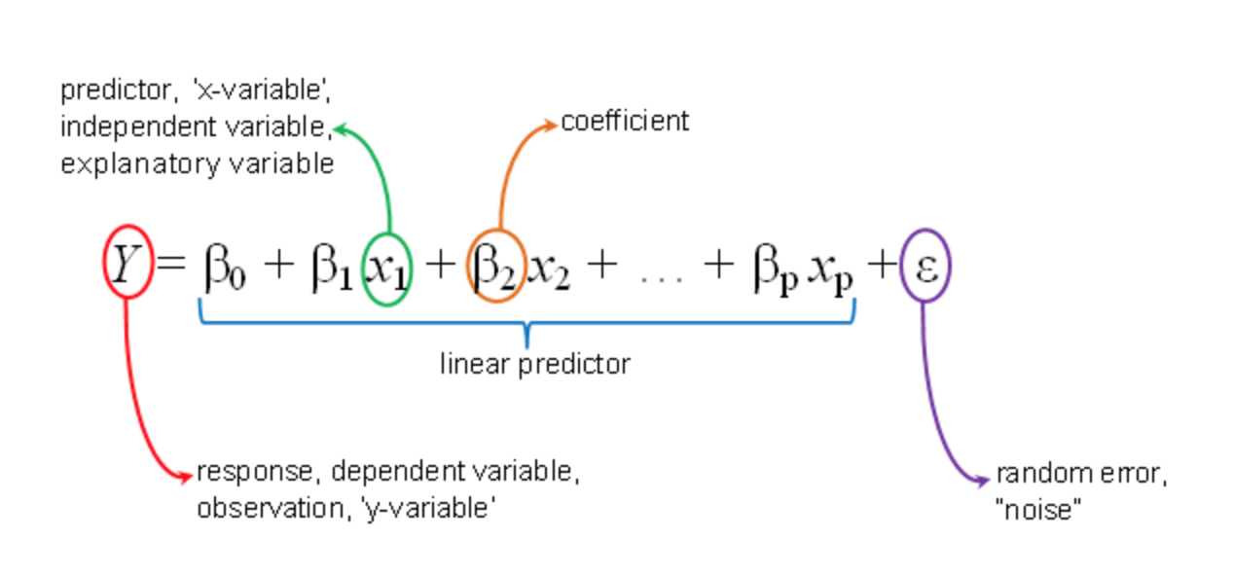

Slide 18
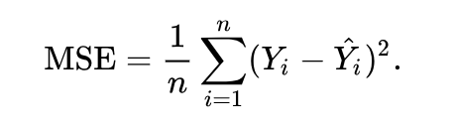
Mean Squared Error
The MSE is a measure of the quality of an estimator—it is always non-negative, and values closer to zero are better.

Slide 19
But what does that all mean?

Slide 21
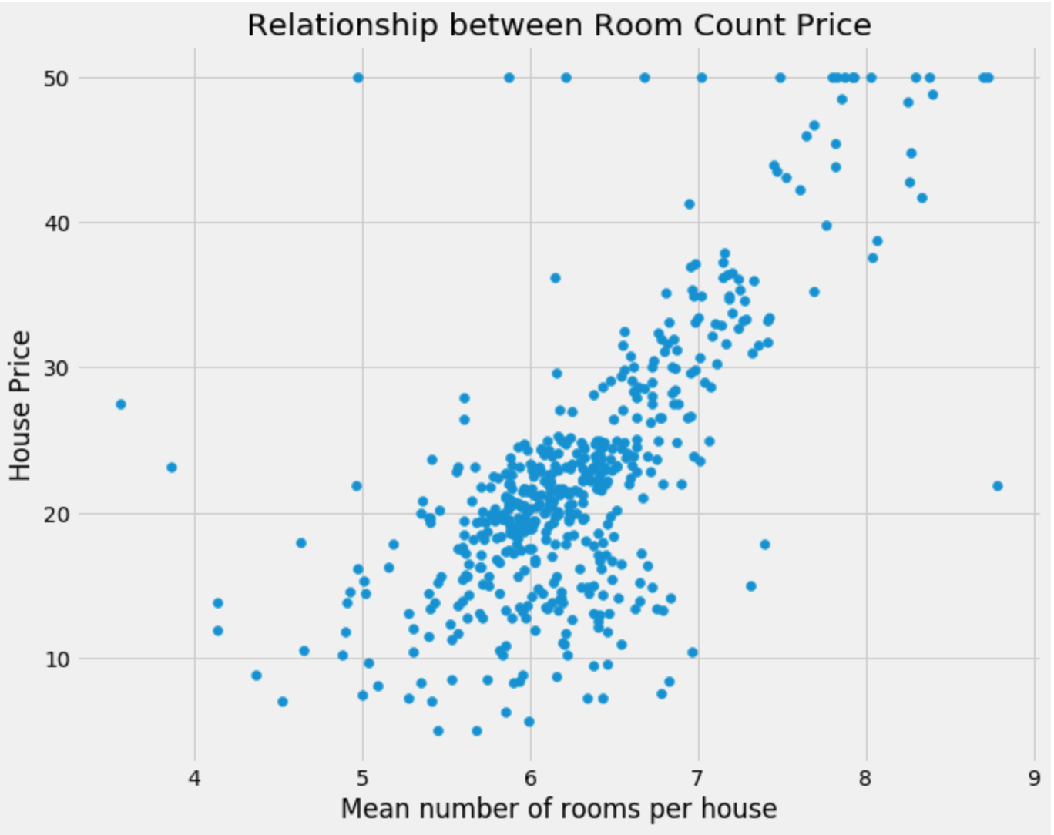

Slide 23
You get to predict new values based off existing data

Slide 24
Thank you

